Slide 1
Algorithms
Mushtari Sadia

Slide 2
Searching and Sorting

Slide 3
Linear Search
def linear_search(arr, target):
for i in range(len(arr)):
if arr[i] == target:
return i # Return the index if the target is found
return -1 # Return -1 if the target is not found

Slide 4
Linear Search
Linear Search Animation by Y. Daniel Liang (yongdanielliang.github.io)

Slide 5
Binary Search
def binary_search(arr, target):
low = 0
high = len(arr) - 1
while low <= high:
mid = (low + high) // 2
if arr[mid] == target:
return mid # Return the index if the target is found
elif arr[mid] < target:
low = mid + 1 # Discard the left half
else:
high = mid - 1 # Discard the right half
return -1 # Return -1 if the target is not found

Slide 6
Binary Search
Binary Search Animation by Y. Daniel Liang (yongdanielliang.github.io)

Slide 7
Ternary Search
if arr[mid1] == target:
return mid1
elif arr[mid2] == target:
return mid2
elif target < arr[mid1]:
right = mid1 - 1
elif target > arr[mid2]:
left = mid2 + 1
else:
left = mid1 + 1
right = mid2 - 1
return -1
def ternary_search(arr, target):
left = 0
right = len(arr) - 1
while left <= right:
partition_size = (right - left) // 3
mid1 = left + partition_size
mid2 = right - partition_size

Slide 8
Selection Sort
def selection_sort(arr):
n = len(arr)
for i in range(n):
min_idx = i
for j in range(i+1, n):
if arr[j] < arr[min_idx]:
min_idx = j
arr[i], arr[min_idx] = arr[min_idx], arr[i]

Slide 9
Bubble Sort
def bubble_sort(arr):
n = len(arr)
for i in range(n-1):
for j in range(n-i-1):
if arr[j] > arr[j+1]:
temp = arr[j]
arr[j] = arr[j+1]
arr[j+1] = temp

Slide 10
Merge Sort
while i < len(left_half) and j < len(right_half):
if left_half[i] < right_half[j]:
arr[k] = left_half[i]
i += 1
else:
arr[k] = right_half[j]
j += 1
k += 1
while i < len(left_half):
arr[k] = left_half[i]
i += 1
k += 1
while j < len(right_half):
arr[k] = right_half[j]
j += 1
k += 1
def merge_sort(arr):
if len(arr) > 1:
mid = len(arr) // 2
left_half = arr[:mid]
right_half = arr[mid:]
merge_sort(left_half)
merge_sort(right_half)
i = j = k = 0

Slide 11
Quick Sort
def partition(arr, low, high):
# Choose the rightmost element as the pivot
pivot = arr[high]
# Initialize the index of the smaller element
i = low - 1
# Iterate through the array from low to high-1
for j in range(low, high):
# If the current element is smaller than or equal to the pivot
if arr[j] <= pivot:
# Swap arr[i+1] and arr[j]
i += 1
arr[i], arr[j] = arr[j], arr[i]
# Swap the pivot (arr[high]) with the element at the partition index (arr[i+1])
arr[i + 1], arr[high] = arr[high], arr[i + 1]
# Return the partition index
return i + 1

Slide 12
Quick Sort
def quicksort(arr, low, high):
if low < high:
# Partition the array
pivot_index = partition(arr, low, high)
# Recursively sort the left and right subarrays
quicksort(arr, low, pivot_index - 1)
quicksort(arr, pivot_index + 1, high)

Slide 13
Count Sort
def count_sort(arr):
# Find the maximum element in the input array
max_element = max(arr)
# Create a count array to store the count of each element
count = [0] * (max_element + 1)
# Calculate the count of each element in the input array
for num in arr:
count[num] += 1
# Calculate the cumulative count of elements
for i in range(1, len(count)):
count[i] += count[i - 1]

Slide 14
Count Sort
# Create an output array
output = [0] * len(arr)
# Place the elements in sorted order
for num in arr:
output[count[num] - 1] = num
count[num] -= 1
return output

Slide 15
Sorting
Sorting (Bubble, Selection, Insertion, Merge, Quick, Counting, Radix) - VisuAlgo
Merge Sort visualize | Algorithms | HackerEarth

Slide 16
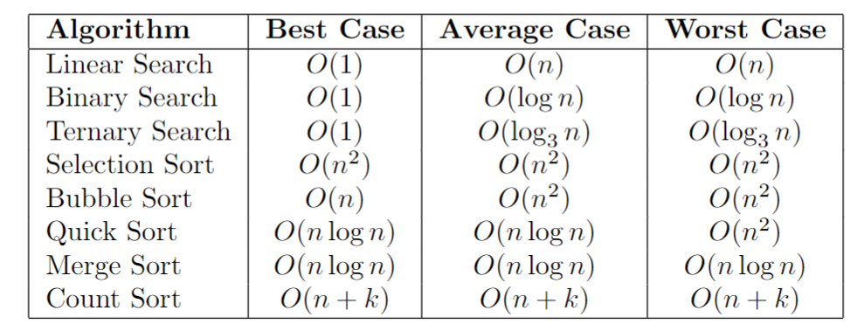
Time Complexity

